Slide 1
sound & tactile sensing

Slide 2
why combine tactile & sound sensors?
applications are very different
but both are (usually) pressure transducers
big difference is the frequency range
  pressure: DC - ~1 Hz
  tactile: ~ 0.1 Hz - ~ 1000 Hz
  sound: ~10 Hz - ~ 10 MHz (or more)
typical devices are electromechanical
  similar – or the same – transducer
  is used as both the transmitter & the receiver

Slide 3
pressure is force per unit area
almost all force – or pressure – sensing technologies involve …
  a mechanical deformation under load
  transduction-to-electrical to measure it
the main exception is for measuring gas pressure under near-vacuum conditions
  then it is typically done at a microscopic level
    cooling rate of an electrically heated filament
    ion current produced by an electron current
    drag on a magnetically-suspended rotor
  these are really density measurements, translated into pressure via P V = n R T

Slide 4
reading (Fraden)
Section 3.10, Sound
  understand Equation 3.105
  be happy with Table 3.3
Section 6.1, Ultrasonic Sensors
Section 7.6, Ultrasonic Sensors
Chapter 9, Force, Strain, Tactile
Chapter 10, Pressure
Chapter 12, Acoustic

Slide 5
topics we will cover
the jargon of sound measurement (briefly)
wave packets & consequent issues
matched filter determination of ToF
problem: beam width & specular reflection
survey of sonar transducers
the “strange” behavior of piezoelectrics
a little about ultrasonic electronics modules
issues in quantitative ultrasonic imaging
tactile sensors & displays
  (if not covered in a future student lecture)

Slide 6
the jargon of sound measurement

Slide 7
sound pressure level (SPL)
“threshold of audibility”, the minimum pressure fluctuation detected by the ear, is less than 10⁻⁹ of atmospheric pressure or about 2 x 10⁻⁵ n/m² at 1000 Hz
“threshold of pain”: pressure 10⁵ times greater
(still less than 1/1000 of atmospheric pressure)
because of the wide range, sound pressure measurements are made on a logarithmic (decibel) scale
“sound pressure level” (SPL) = 20 log(P/P₀) =
10 log(P/P₀)², where P₀= 2 x 10⁻⁵ newton/meter²
  because energy and power scale as pressure squared
  caution: pay attention to when P = pressure and when P = power
SPL is proportional to the average squared amplitude

Slide 8
sound power (SP & PWL)
SP = total sound power W emitted by a source in all directions
(in watts = joules/second)
sound power level
PWL = 10 log(W/W₀) decibels
  where W₀ = 10⁻¹² watt (by definition)
= 10 log(P/P₀)² decibels
= 20 log(P/P₀) decibels
in terms of pressure

Slide 9
sound intensity level (IL)
rate of energy flow across unit area
sound intensity level
IL = 10 log(I/I₀)
  where I₀ = 10⁻¹² watt/meter²

Slide 10
multiple sources
two equal sources produce a 3 dB increase in sound power level
  because log₁₀2 = 0.301029996
  10 log₁₀2 ≈ 3
two equal sources produce a 3 dB increase in sound pressure level (assuming on average no interference,
i.e., incoherent random phases)
for example, when two 80 dB SPL sources add
the result is an 83 dB SPL
(assuming they are incoherent)

Slide 11
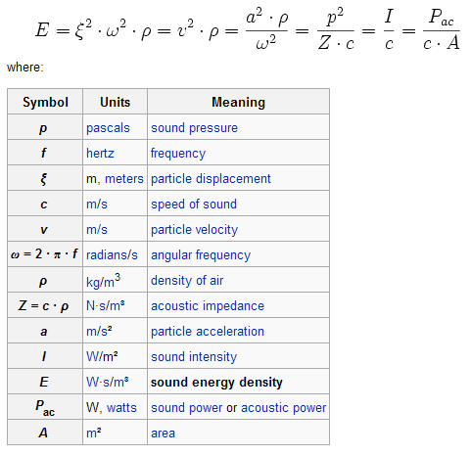
tying all these & more together …
see http://en.wikipedia.org/wiki/Sound_energy_density

Slide 12
exercise
An acoustic sensor, in the absence of any signal of interest, outputs an RMS noise level of 500 μV. When an acoustic signal of interest is added, the sensor’s RMS output becomes 1300 μV. What is the signal-to-noise power ratio expressed in decibels? What would it be if the sensor’s RMS output were to become 2 V when signal of interest is added? [Note: be careful about (1) how RMS quantities add (2) the distinction between signal-to-noise and (signal+noise)-to-noise]

Slide 13
ranging by wave packet ToF
emit a pulse of acoustic energy
detect its echoes from nearby objects
measure the time-of-flight (ToF) of each
multiply by speed-of-sound to get ranges
issues:
  directionality: which object at which azimuth
  signal diminishes with range
    spreading: energy density decrease (1/z²)
      all waves diminish as 1/z^{(dimensionality_of_space -1)}
    attenuation: energy loss to heat (exponential)
      inherent in nature of sound (but not light)

Slide 14
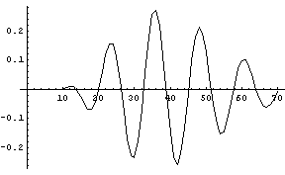
the “wave packet” concept
a “wave packet” is a finite-duration burst
of transmitted energy (acoustic, light, etc)
  τ measures its duration
  t_{o} measures its mean time
  often it is – or is approximated as – Gaussian:
  A(t) = A_{o} exp[-((t-t_{o})/τ)²] cos(2π f (t-t_{o}))

Slide 15
problem: range jumps
cheap systems commonly detect the time
of echo amplitude crossing a threshold
threshold ~ 0.2
threshold ~ 0.1

Slide 16
solution: matched filter
correlate incoming signal with its expected shape, i.e., the shape of the outgoing pulse
but it’s not quite as easy as you would like:
dispersion and differential attenuation
distort the echo vs. the outgoing pulse
  dispersion: velocity depends of frequency
    issue for sound and for light in a medium
  differential attenuation: amplitude decay per unit distance covered depends on frequency
    this is the energy dissipation phenomena,
    not the universal geometrical spreading

Slide 17
nevertheless, here is a seat-of-the-pants picture of how matched filters work

Slide 18
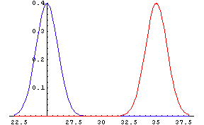
envelopes of pulse and echo

Slide 19
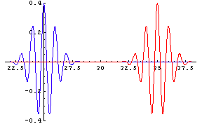
underlying ultrasonic oscillation

Slide 20
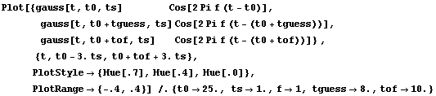
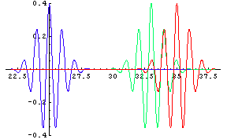
pulse – guess – echo

Slide 21

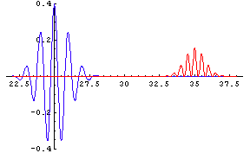
guess * echo when error = 0. period

Slide 22

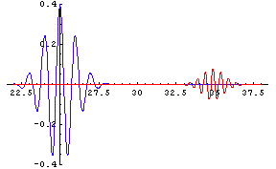
guess * echo when error = .25 period

Slide 23

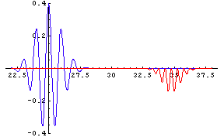
guess * echo when error = .5 period

Slide 24

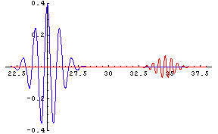
guess * echo when error = .75 period

Slide 25

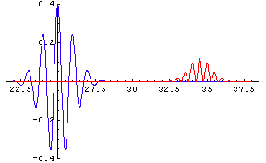
guess * echo when error = 1.0 period

Slide 26
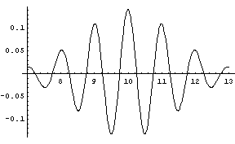
integral of guess * echo over time plotted as function of guess

Slide 27
exercise
Describe the frequency spectrum of the wave packet used in the previous example.
[hint: In general Δf Δt ≥ 1/(4π), and for a Gaussian envelope ≥ can be replaced by ≈.
A wave packet that is Gaussian in time has a Gaussian frequency spectrum. Given all that, you need only to estimate its center & width.]
How will dispersion and differential attenuation affect time-of-flight measured by this method?

Slide 28
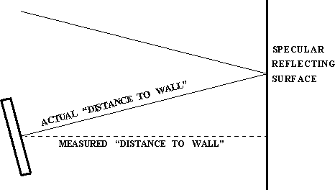
problem: beam width
specular surfaces are visible – by specular reflection – at “non-specular” angles
walls appear as arcs in ultrasonic range images
(that use co-located transmitter and receiver)

Slide 29
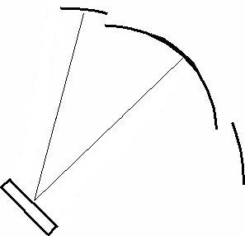
so walls appear as broken arcs:
(when using threshold detection)

Slide 30
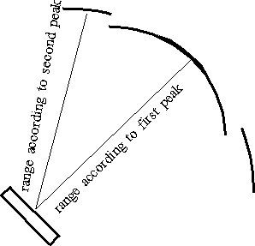
since as the signal gets weaker (with angle) the apparent time-of-flight gets longer ...

Slide 31
survey of transducers and electronic modules for ultrasonic range sensing

Slide 32
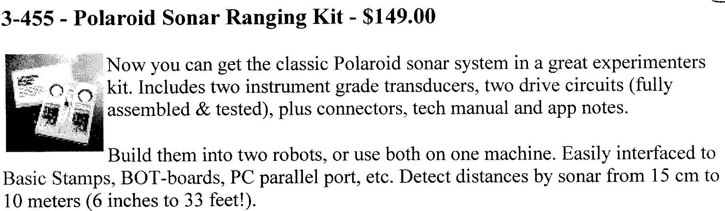
Polaroid (electrostatic) transducers
http://www.robotstorehk.com/sensor/sensor.html
http://www.robotstore.com/download/3-740_Sonar_Exp_instr_1.02.pdf

Slide 33
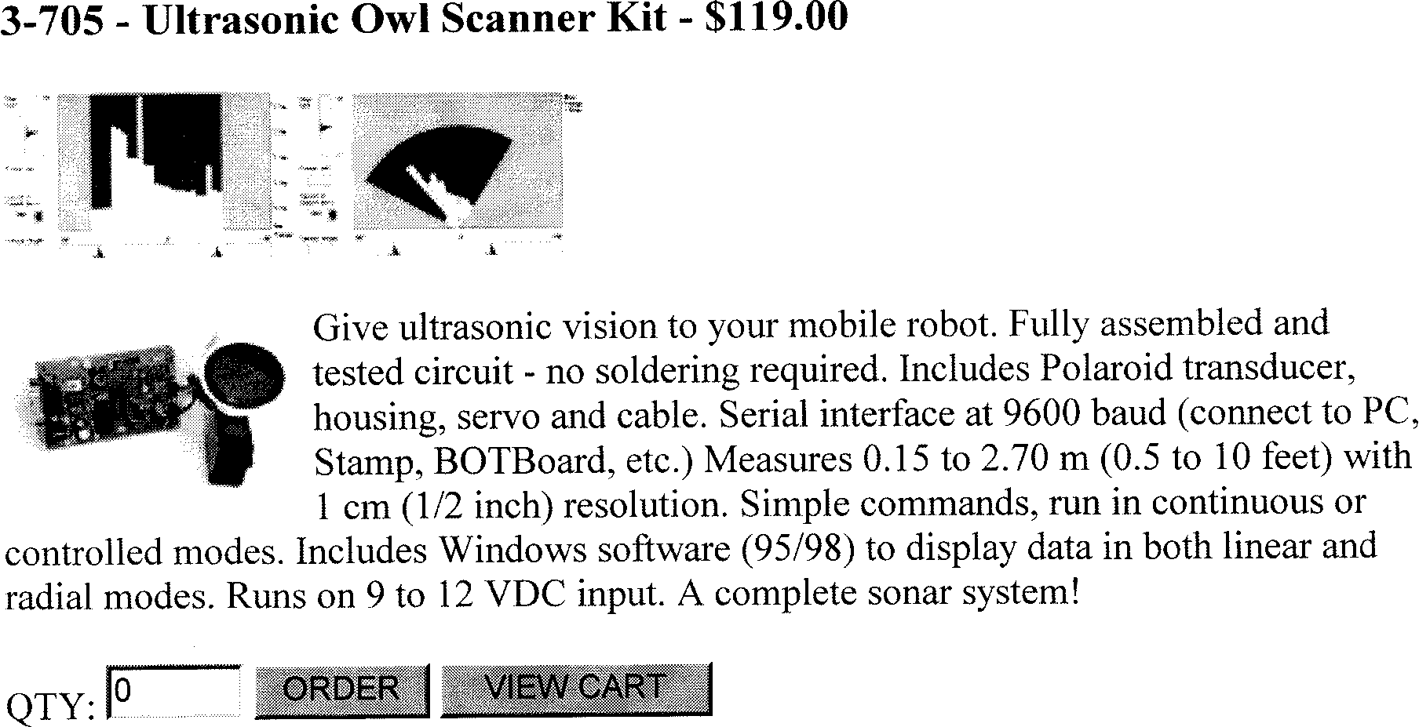
Polaroid-transducer systems

Slide 34
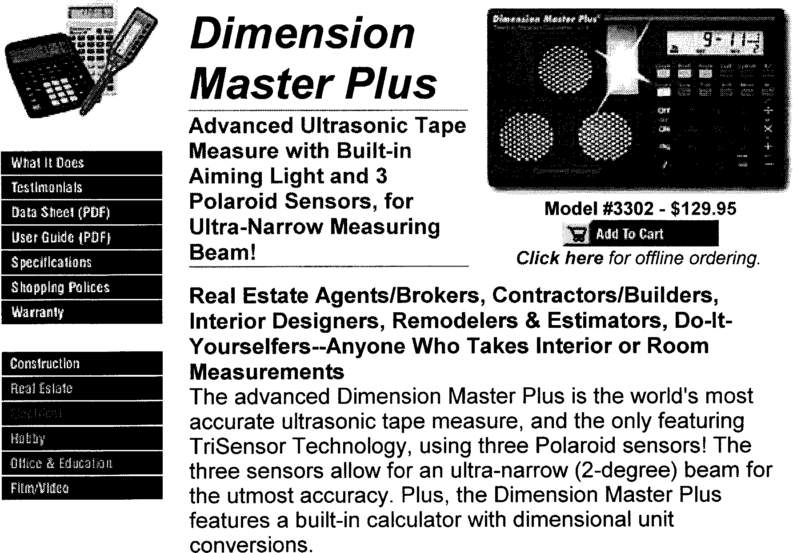
Polaroid-transducer instruments
http://www.calculated.com/UsersGuides/3302mn.pdf

Slide 35
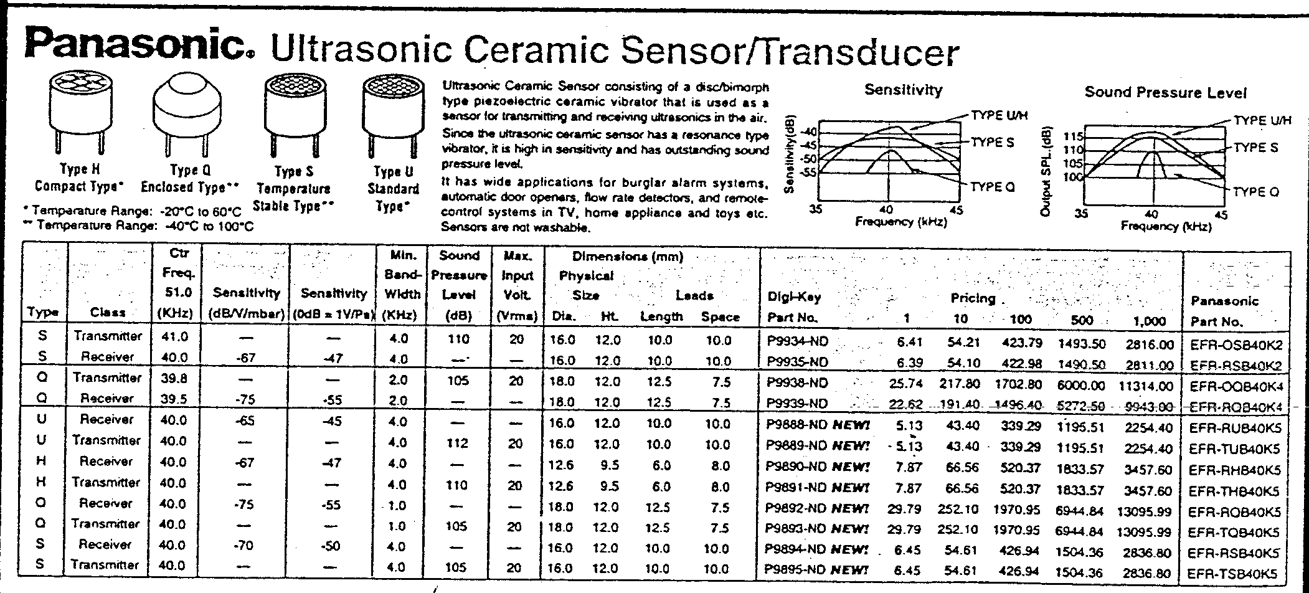
Panasonic (piezoelectric) transmitters and receivers

Slide 36
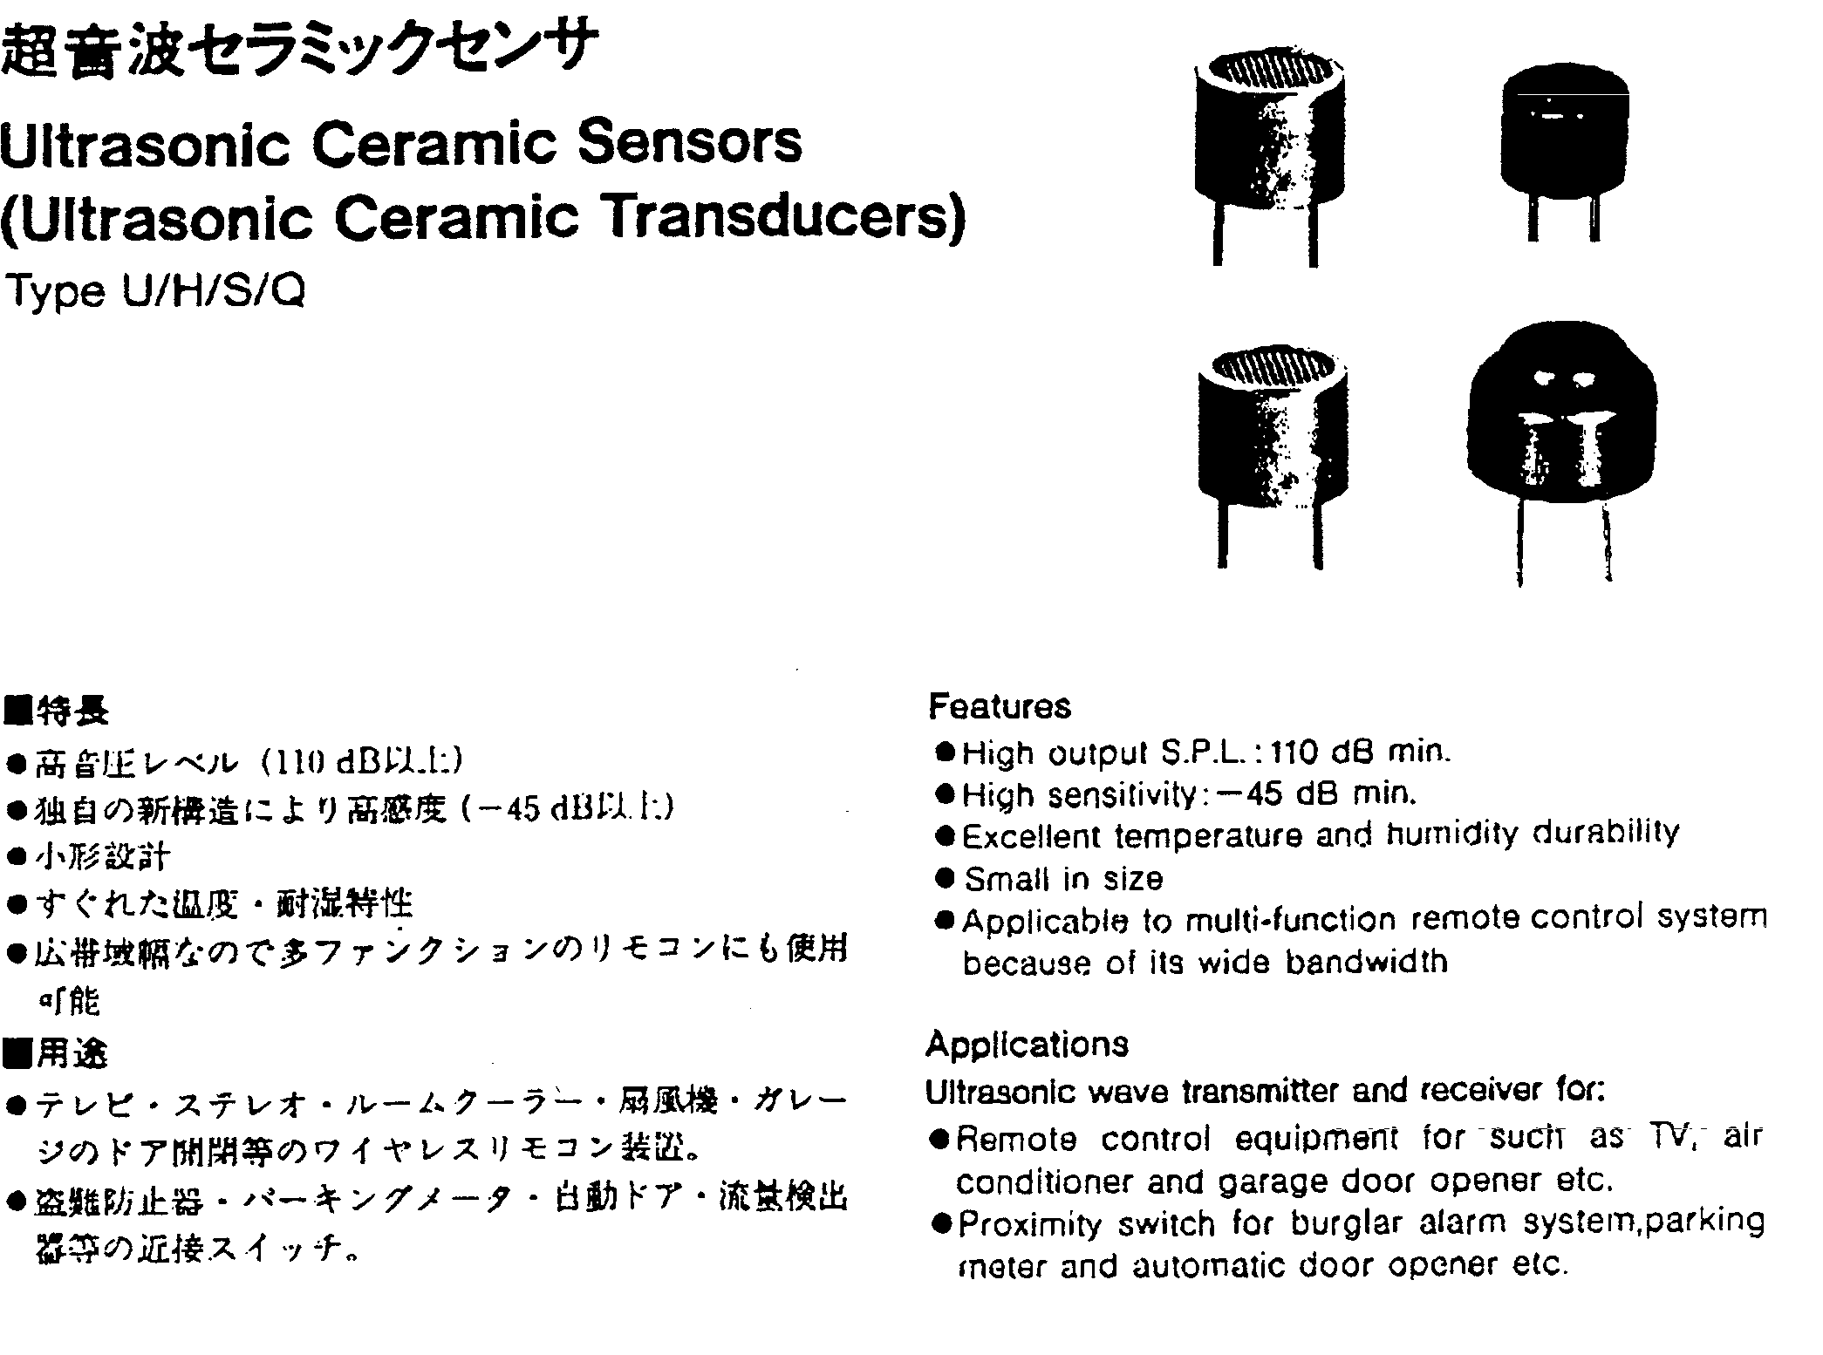

Slide 37
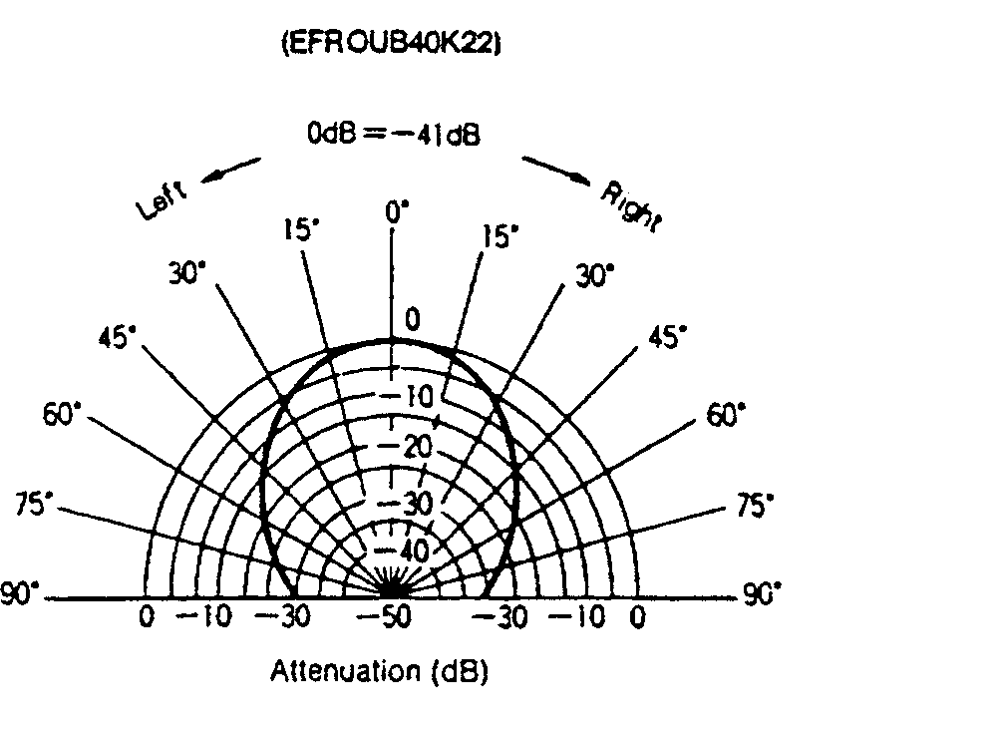
beam “width” (angular distribution)

Slide 38
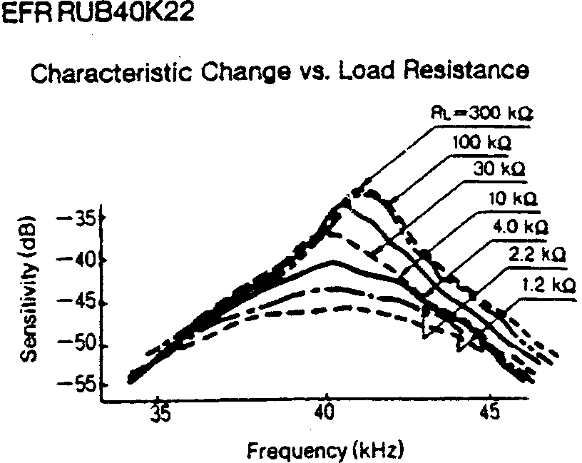
sensitivity vs. frequency & load

Slide 39
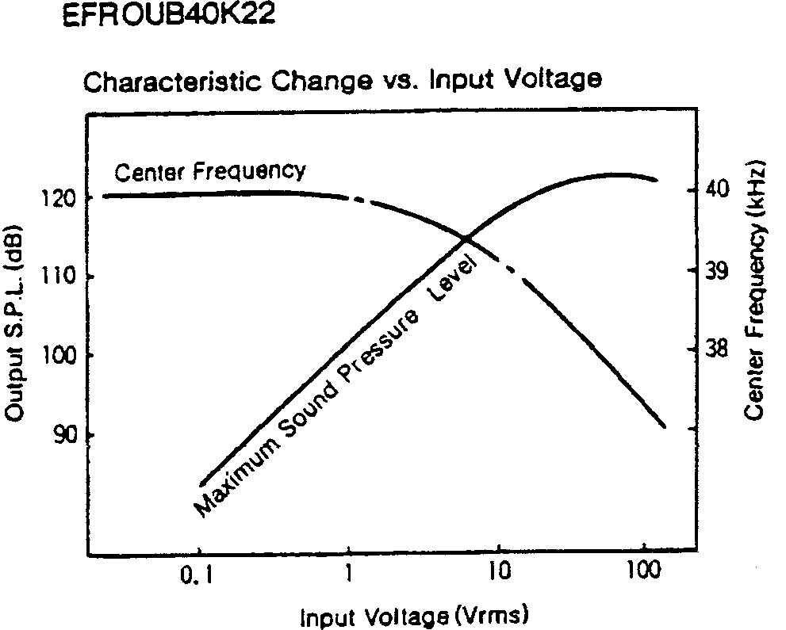
frequency & output vs. drive

Slide 40
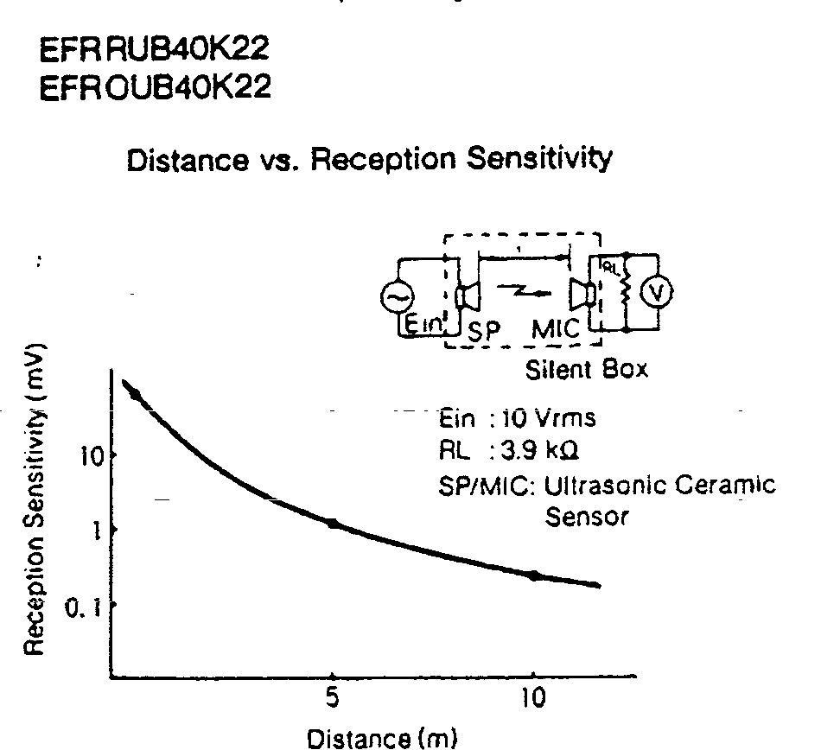
received signal vs. distance

Slide 41
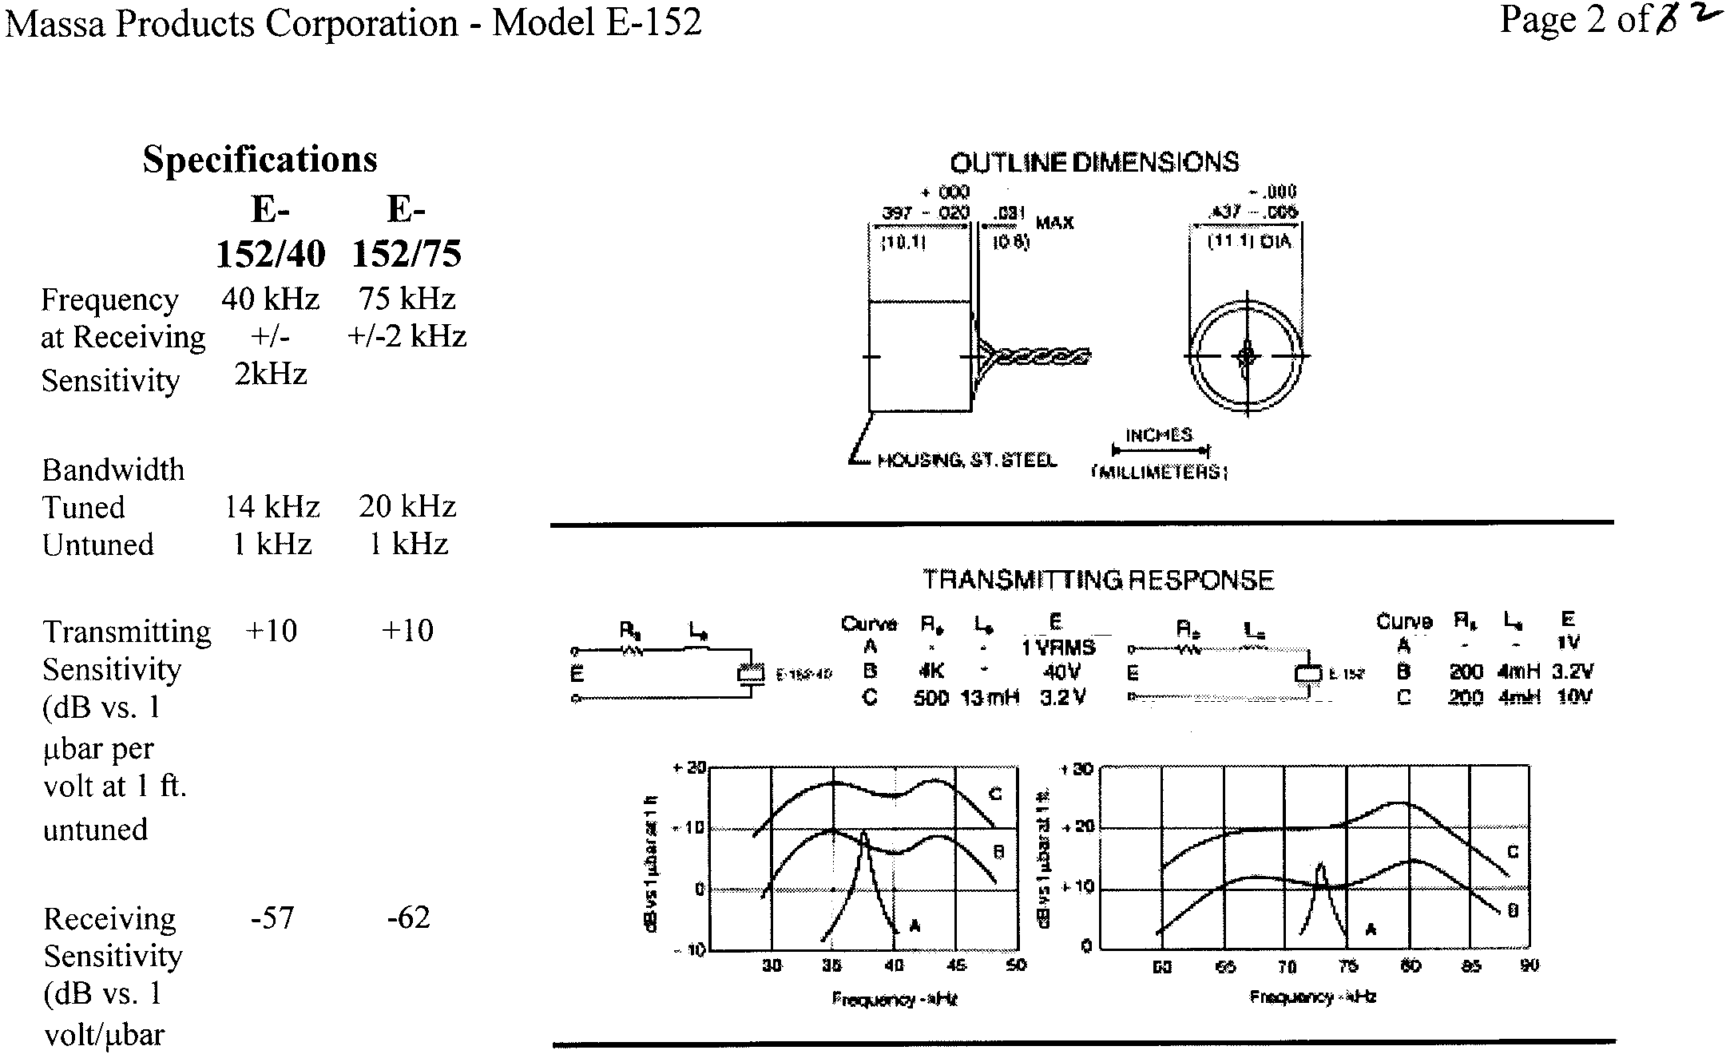
Massa 40 kHz & 75 kHz Models

Slide 42
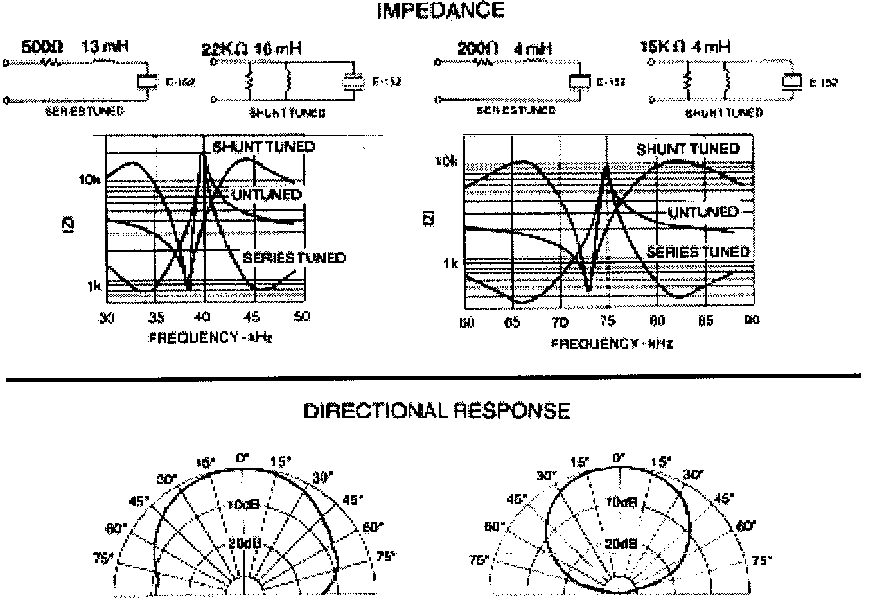
impedance & angular distribution
Note higher frequency
(shorter wavelength)
has narrower beam

Slide 43
the “strange” resonance characteristics of piezo-electric transducers

Slide 44
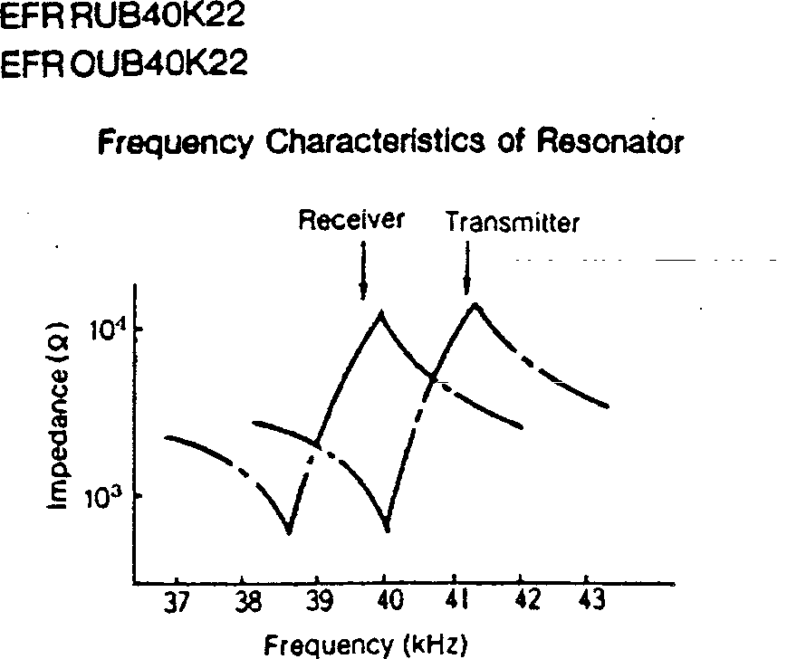
resonance characteristics

Slide 45
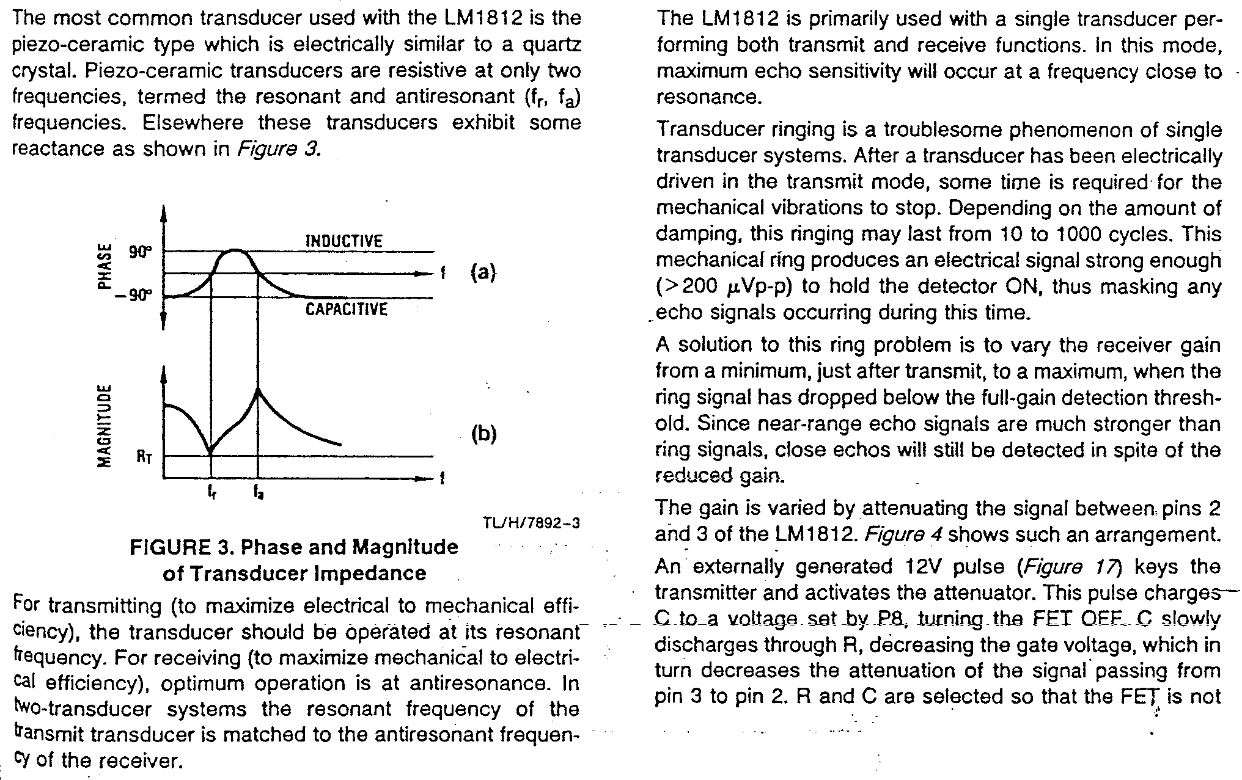
impedance vs. frequency

Slide 46
sonar electronics modules

Slide 47
time-dependent amplification
receiver amplifier gain is typically “ramped” approximately linearly with
time after acoustic pulse emission
this helps suppress direct coupling (i.e., not via echo) between transmitted pulse and electronic detection circuit
but primarily it is used to compensate signal strength fall off with distance
but you can’t do it forever … eventually you’ll just be amplifying noise

Slide 48
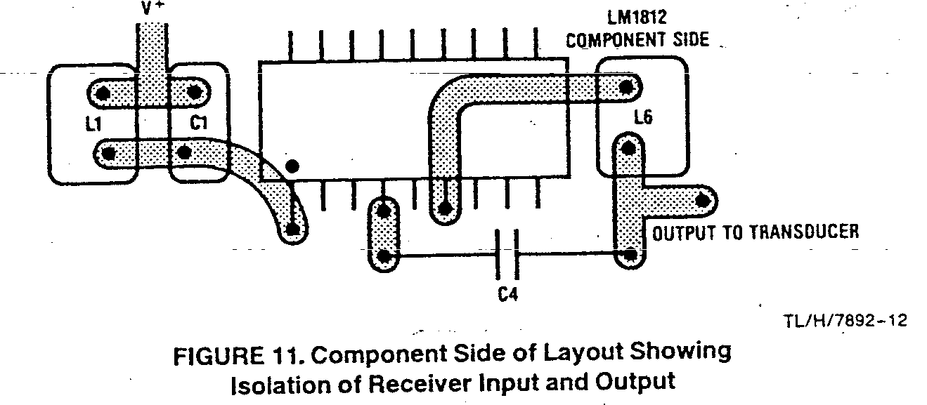
circuit layout issues to achieve isolation of transmit and receive

Slide 49
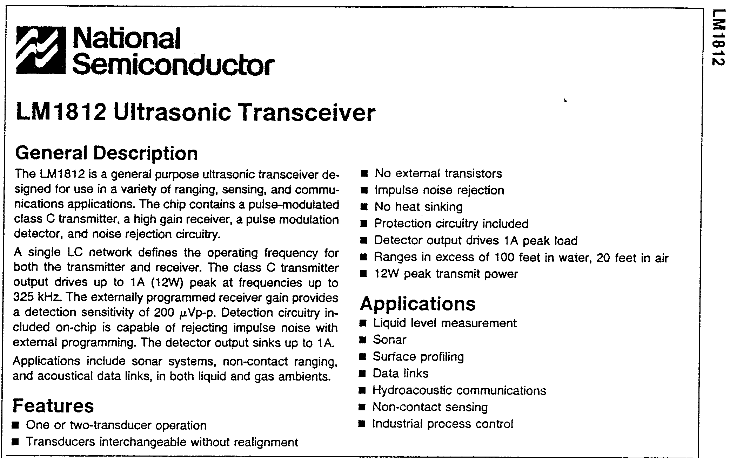
IC for sonar applications

Slide 50
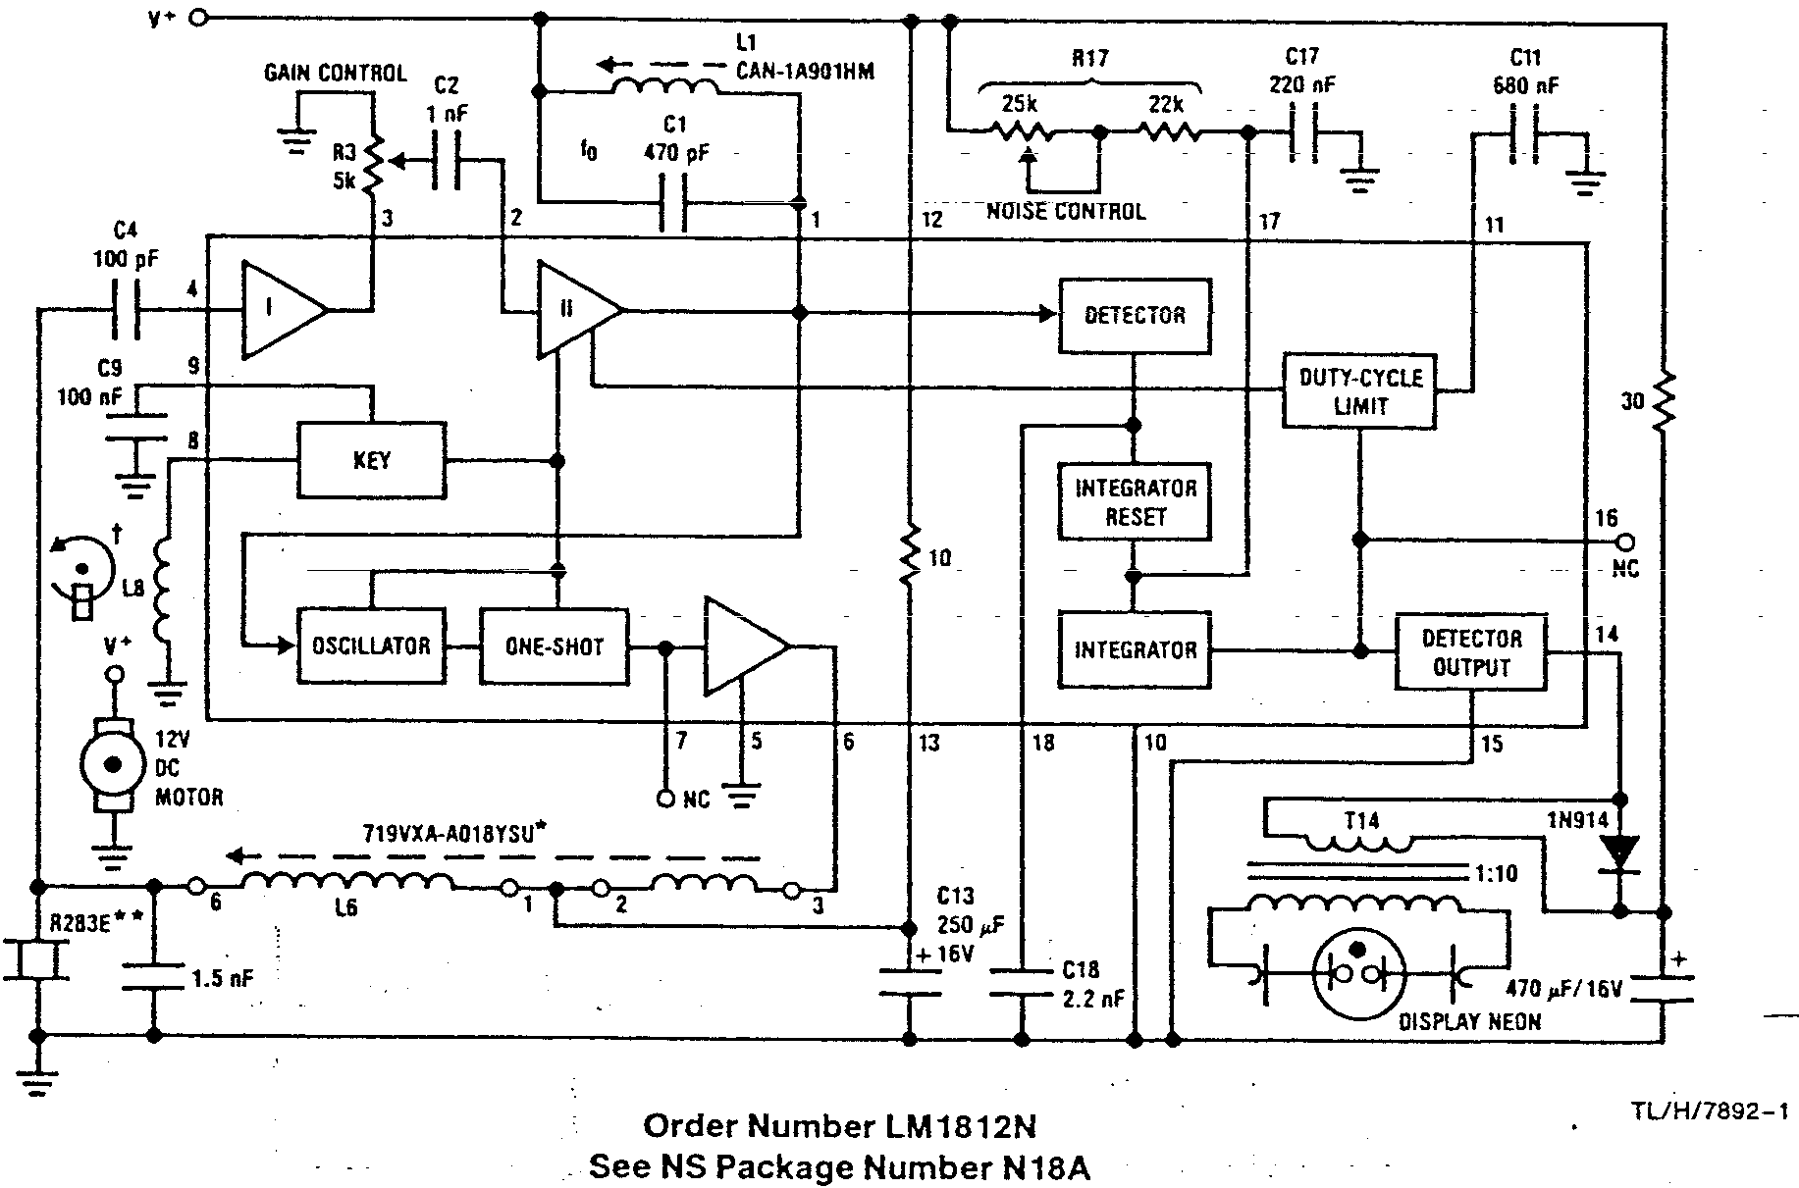
circuit functional details

Slide 51
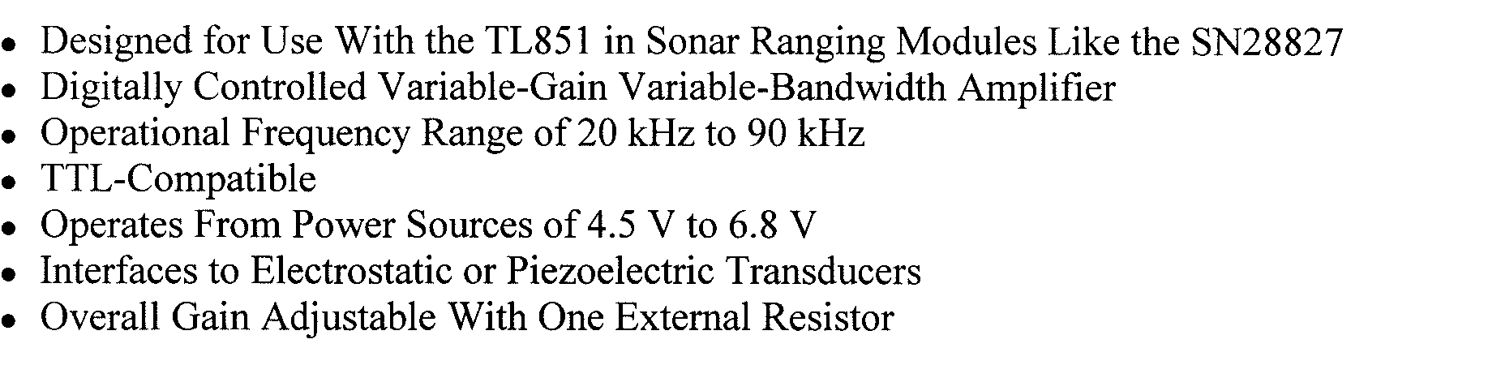
TI TL851/2 hybrid analog-digital
often used with Polaroid (electrostatic) transducers as alternative to the
Polaroid-supplied electronics

Slide 52
some issues in
quantitative
ultrasonic
imaging

Slide 53
e.g., in medical imaging …
speed of sound in “flesh and blood” is:
  not known
  not constant (even in one individual subject)
  not amenable to measurement using “manufactured artifacts”
so if precisely scaled range is needed,
an “in situ” calibration method is required

Slide 54
“average” or “typical” values are fine:
  for qualitative visualization,
  pathology / diagnosis, etc
  but probably not for, e.g.,
  custom design of wheelchair cushions
  and certainly not for, e.g.,
  planning a micro-surgical path

Slide 55
problem
image guided surgery literature seeks:
  navigational accuracy ~ 1 mm
  endpoint precision ~ 0.1 mm
ignorance of precise acoustic properties of skin, fat, muscle, etc, layers makes these specifications problematic

Slide 56
approach
identify elementary cases
invent in situ calibration protocols for them:
  multiple parallel homogeneous layers
  speed of sound gradient in a single layer
  a tapered layer
assume
  any real case is a (separable) combination
  of the elementary cases
  mechanically accurate scanning capability

Slide 57
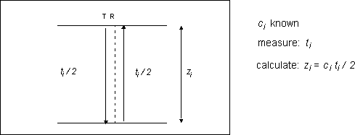
basic ToF technique
a single-sided ultrasonic thickness measurement method
  presumes speed of sound c_{i} is known

Slide 58
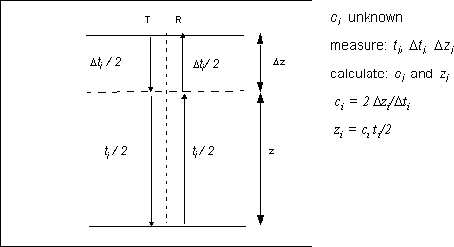
and a differential method
  presumes speed of sound c_{i} does not change with thickness

Slide 59
one homogeneous layer
two (or more) oblique paths
  overcomes the presumptions of the
  normal path methods
  however, possible confusion from
  diffuse reflection!
  if i>2 a least-squares solution will
  optimize accuracy

Slide 60
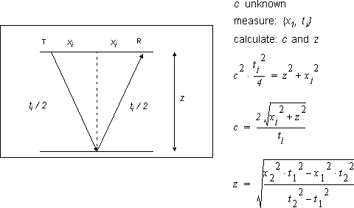

Slide 61
several parallel homogeneous layers
select two values of x₁; measure corresponding two values of x₂
  mainstay of geoacoustics, e.g.,
  oil prospecting in complex rock strata
  need to assume the paths are distinguishable by, e.g., signal amplitude

Slide 62
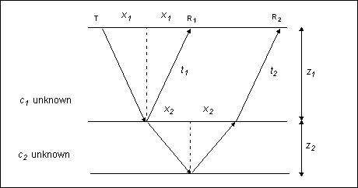

Slide 63
parallel layers with velocity gradient
sinθ/c = k holds even if c is a function of position
  acoustic trajectory is then curved)
continuous c causes refraction but not reflection
if c is a linear function of position (depth)
then the curved path is a circular arc
this result is a mainstay of underwater acoustics, where temperature and salinity gradients lead to speed-of-sound gradients
three T/R separations are enough to measure
c₀, z, and the launch angles {θ₁, θ₂, θ₃} corresponding to the chosen {x₁, x₂, x₃}

Slide 64
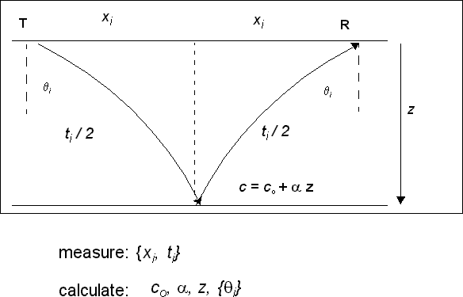
note: compare with the
“mirage” effect, where
you have reflection
that doesn’t require any
reflecting surface

Slide 65
nonparallel layers
acoustic time-of-flight defines an elliptical locus to which the reflecting discontinuity is tangent
there is usually only one physically reasonable line that is tangent to two such ellipses
  so if c is known, two {x_{i},t_{i}} pairs fix the depth
  and angle of inclination of the reflecting plane
  an additional pair will resolve any ambiguity
  when c is not known in advance, an additional pair is sufficient to find both c and the correct reflecting plane

Slide 66
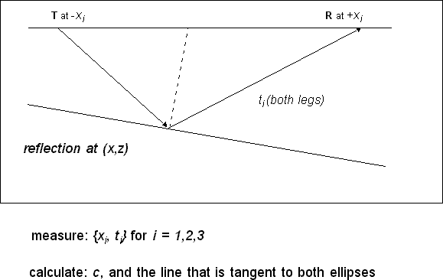


Slide 67
tactile sensors
&
displays

Slide 68
recommended reading
classic tactile sensing articles for history:
  Nicholls & Lee (~1990)
  Leon Harmon (~1982)
current robotics literature for latest gadgets
articles cited
  older articles on next page
  hopefully newer articles cited in
  up-coming student lecture

Slide 69
older tactile sensing literature
Harmon, L.D., Automated Tactile Sensing. International Journal of Robotics Research, 1982. 1(2): p. 3-32.
Pugh, A., Tactile and Non-Vision. Robot Sensors, ed. A. Pugh. Vol. 2. 1986, Bedford UK: IFS (Publications) Ltd and Springer-Verlag.
Nicholls, H.R. and M.H. Lee, A Survey of Robot Tactile Sensing Technology. International Journal of Robotics Research, 1989. 8(3): p. 3-30.
Ron Fearing: http://robotics.eecs.berkeley.edu/~ronf/tactile.html
National Academy Press, Expanding the Vision of Sensor Materials. 1995. (Appendix A, references)
http://books.nap.edu/books/0309051754/ 101.html#pagetop
also: medical-tactile sensing (not covered explicitly here)

Slide 70
tactile sensing
simulating (sensors)
and
stimulating (displays)
the
human sense of touch

Slide 71
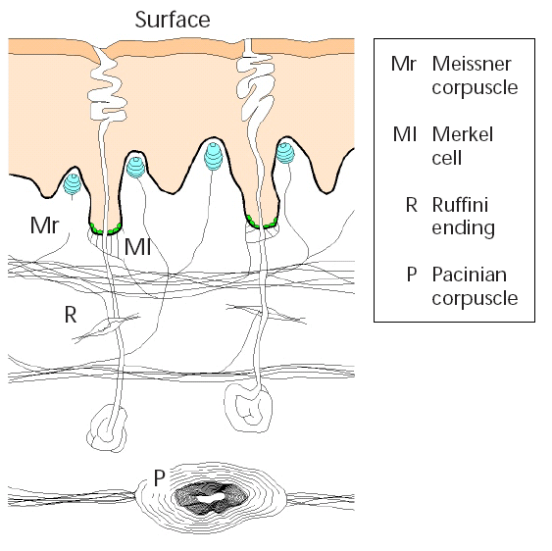
human skin tactile sensitivity
at least four different kinds of sensor cells
different spatial and frequency sensitivities

Slide 72
speculative specifications fingers
“ideal stimulator” would provide 50 N/cm² peak pressure, 4 mm stroke, and 25 Hz BW (Fearing)
skin acts like a spatial low-pass filter
  when we handle flexible materials (fabric, paper) we sense the pressure variation across the finger tip
fingertip mechanoreceptor bandwidth ~30 Hz
density 70 cm⁻² (resolve ~1.2 mm between points)
finger curvature, thermal properties, and other environmental factors seem critical to teletaction

Slide 73
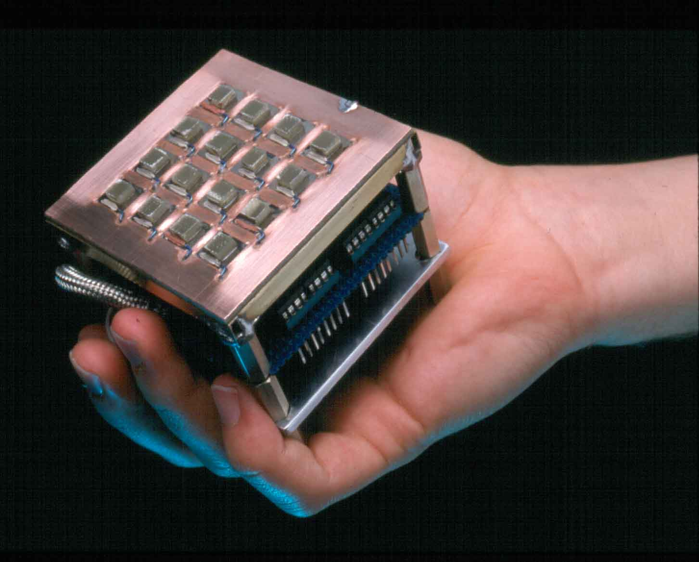
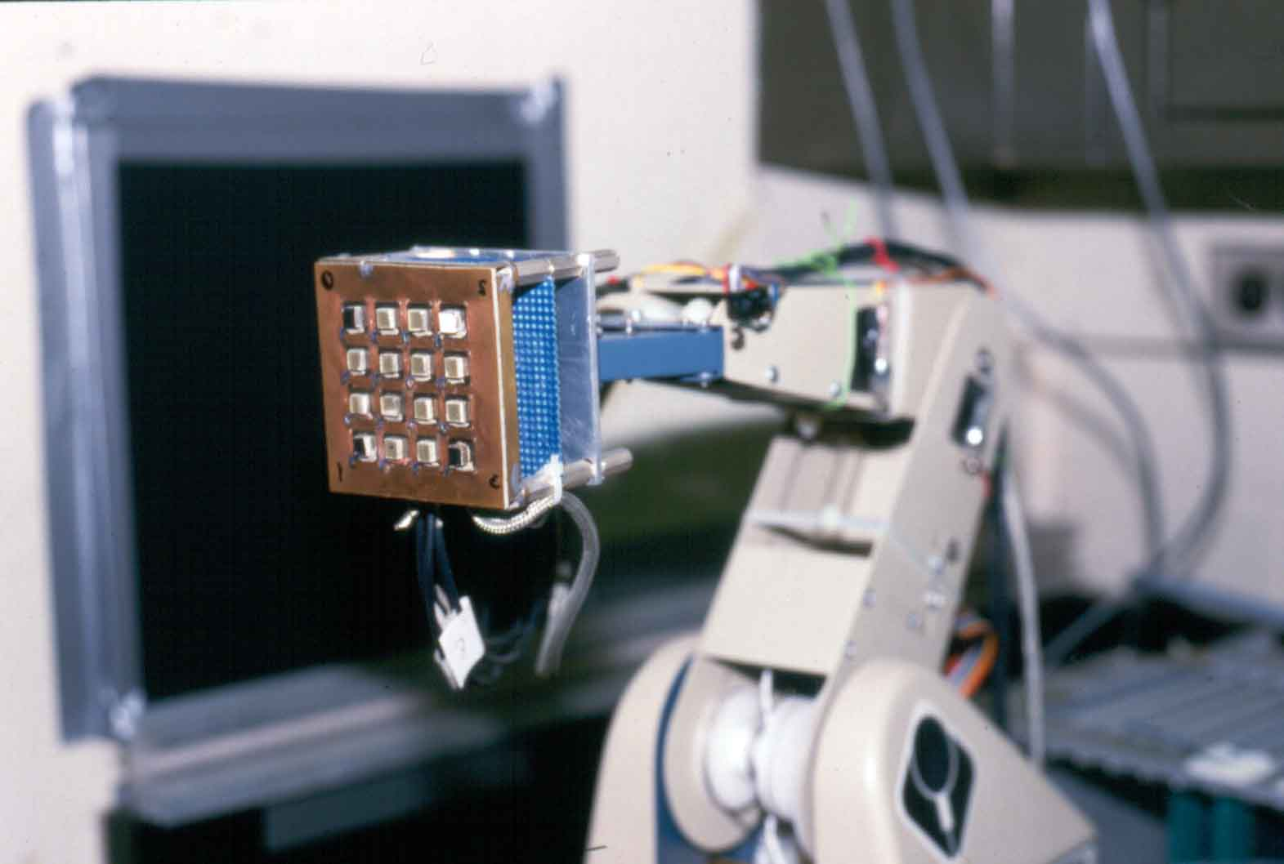
conceptual tactile sensor array (Fearing)
and mine ~1983

Slide 74
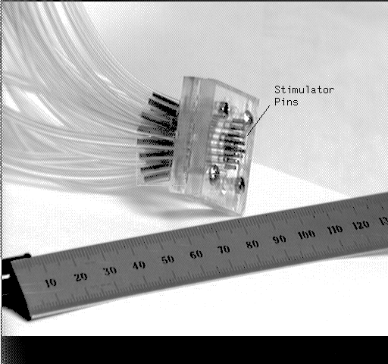
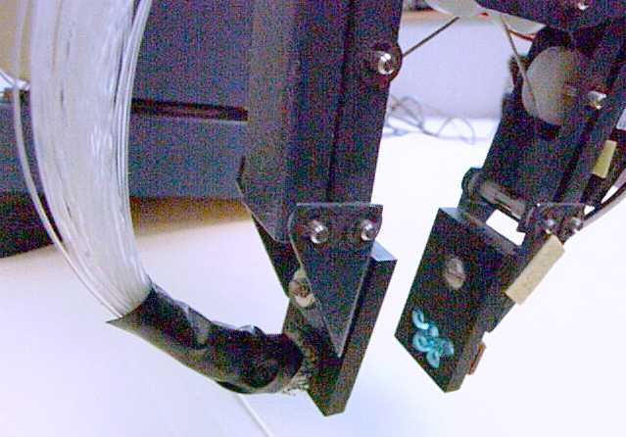
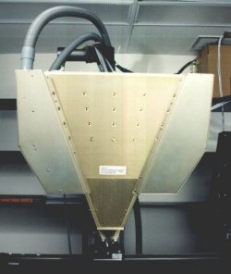
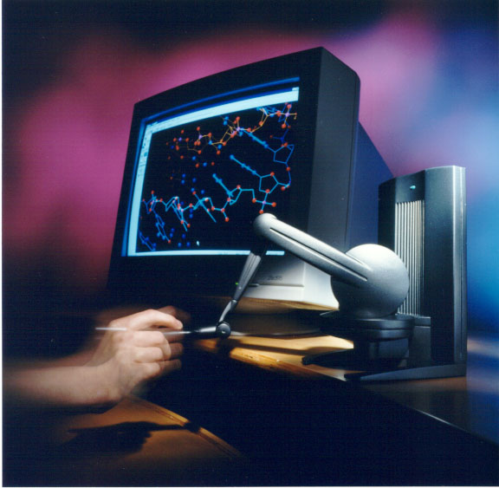
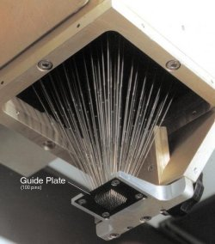
current haptic interfaces and tactile displays
virtual reality
people with disabilities
UC Berkeley
Robotics Lab
and mine ~1985
John Hopkins University
Somatosensory Labs
MIT’s Phantom (now by startup SenSation)

Slide 75
tactile sensor requirements
see the Leon Harmon articles:
  surveyed industry, government, research people to ascertain the specs they thought tactile sensing for robotic assembly etc. required
  (but how did they know??)
“blue sky” and practical requirements:
  skin-like sensors, hand-like actuators, low-level processing
  practical specifications summarized in Nicholls article
financed by Lord Corporation
  defunct product: tactile sensor array for robotics

Slide 76
a solution in search of a problem?
identification or location?
agree with Nicholls and Lee’s conclusion that vision is well-developed and probably fundamentally better for identification ... better role for tactile is precise relative location
difficulty & importance of slip sensing
  literature often mentions “incipient slip”, but it is never clear what it means
  coefficient of friction decreases once slip begins, making recovery difficult

Slide 77
real-world applications of tactile sensing
T. Goto, T. Inoyama, K. Takeyasu (Hitachi, Japan): Precise Insert Operation by Tactile-Controlled Robot (in the Pugh book, 1986!!)
  “The HI-T-HAND Expert-1 assembly robot has now been completed. Its delicate tactile control is capable of inserting a shaft into a hole with a clearance of 20 micrometers, faster and more dexterously than in a human operation. It is impossible for conventional robots and automatic assembling machines to perform such operations of precision insertion. Accordingly, such operations have been left for man’s hand to perform. Now, however, the sequence controller makes it possible, without the use of a computer for robots to perform certain of these functions.”
this is the ONLY one I know!

Slide 78
technologies for tactile sensing

Slide 79
you name it, IT’S BEEN TRIED!
momentary switch contact
spring + LVDT or some such analog pressure measurement
  including MEMS techniques, e.g., strain gauges on diaphragms
force sensitive resistor (with or without built-in mechanical threshold)
capacitative or optical measurements of surface deformation
liquid crystal (color &/or opacity changes with deformation)

Slide 80
total internal reflection
(e.g., for fingerprints)
phonograph needle for slip/vibration
(do you know what it is?)
thermistors etc for temperature/thermal conductivity etc
piezoelectric, pyroelectric (e.g., PVDF)
etc etc etc

Slide 81
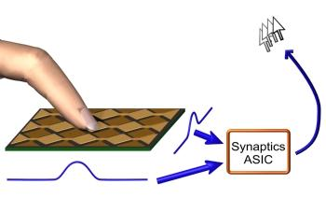
most commonplace, maybe most promising: “touch pad” capacitive arrays
http://www.synaptics.com/technology/cps.cfm
exception to the generalization:
this is a “proximity” vs. a “pressure” sensor!
a good example of the
principle that if Y (in
the environment) makes
X (a resistor, capacitor,
etc) BAD, then a BAD
design for X can be
exploited to as a
GOOD sensor for Y

Slide 82
a little philosophy: the synergy of sensor & display development

Slide 83
tactile displays THEN tactile sensors?
television and telephone: analogy
  contrived sensor is secondary to natural display
    make the best speaker you can ... then optimize microphone
    make the best TV display you can ... then optimize camera
    (until recently ... computer-understanding changes the rules ...)
radar and sonar: contrast
  contrived display is secondary to a trans-human sensor
    raw data initially as peaks, wiggles, etc, in signal vs. time plot
    human-centered displays later conceived and developed for non-experts, natural interpretation even by experts, etc

Slide 84
a principle?
there is no point in making a display with more resolution than your best sensor
  in any domain:
  spatial, temporal, dynamic range, color, etc
  (unless you have a virtual sensor that is better!)
there is no point in making a sensor with more resolution than your best display
  (though in many domains you can “zoom in”)
so improvement cycles display ↔ sensor

Slide 85
piezo-resistive sensors

Slide 86
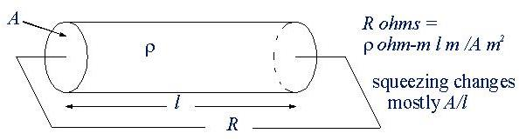
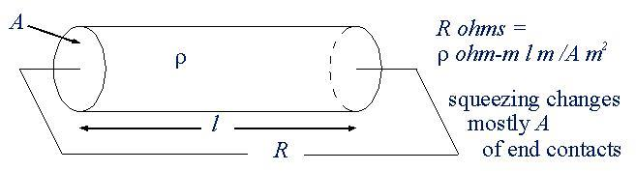
pressure sensitive resistors (PSR)
bulk resistance vs. contact resistance

Slide 87
PSR magnitude
Nicholls and Lee say few hundred to few thousand ohms is typical ...
my experience is that common conductive foams (IC packaging etc) etc are typically 1000 - 10000 times higher ...
  so high impedance measurement techniques must be employed
  and time response (τ = RC) can suffer

Slide 88
PSR noise
no general theory (that I know)
contact-resistance-based designs are noisy
surface effects are noisier than volume effects
  density of opportunities for trouble is higher
  in a space of lower dimensionality
    a single defect is fatal in 1-dimension
but depending on details of the particular design, under microscopic examination distinction may not be clear
  bulk resistance change may be due to distortion (A/l)
  but it can also be due to changes in inter-grain contact

Slide 89
exercise
A cylindrical resistive element is compressed or stretched in a way that does not change its basically-cylindrical shape, and does not change its volume; assuming its resistivity does not change either, derive how ΔR/R (fractional change in resistance) depends on ΔL/L (fractional change in length).

Slide 90
piezo-electric sensors

Slide 91
piezo- and pyroelectric devices
piezo- (pressure) and pyro- (heat) electricity are
always coupled
it is due to separation of electrical charges in the
material’s crystalline arrangement
  electric dipoles at the molecular level (e.g., H₂O)
  high voltage poling to macroscopically align dipoles
  “electrets” made by poling various waxy mixtures
pressure → voltage (sensor)
voltage → deformation (actuator)
due to leakage, effect is transient
  to stabilize, leakage is intentionally increased, making device response effectively to dP/dt
high voltage + high input impedance → tiny current
(hard to measure, slow to measure)
O
H
H

Slide 92
practical piezoelectric materials
quartz (cut along particular crystal axes to maximize piezo- and minimize pyro- effects)
  effect small but very stable
various ceramics, e.g., ZnO, PZT^{(TM)}
  deposition on micro- and mini- fabricated devices
    SAW (surface acoustic wave) devices for sure
    MEMS devices discussed but not sure whether implemented
plastics: polyvinylidene difluoride (PDVF, PVF₂)
  enormous quantities are reportedly used in submarine sonar transducers
    yeah, so why is it so expensive?

Slide 93
magnitude of piezoelectric effect
easy to get tens of volts but need high input impedance measuring instrument
can get very high voltages (enough to spark across ~ 1 mm) in response to impact
  buy yourself a “flintless” butane lighter

Slide 94
capacitive sensing

Slide 95
capacitive devices
“mouse pad” or “touch pad” is now ubiquitous, reliable, stable
same geometrical factors as resistive sensors (but remember that capacitance is defined “upside down”:
V = L dI/dt + R I + Q/C
actual approach is to measure distortion in “stray” capacitance
(again) see http://www.synaptics.com/technology/cps.cfm
many geometries, including some “finger-like” curvatures

Slide 96
magnitude of capacitive effects
μ₀ = 4π 10⁻⁷ henry/m, ε₀ = μ₀/c² = 8.85 10⁻¹² farad/m
“small capacitor” is ~ 100 pF (p = pico = 10⁻¹²)
say you want to see a 1% change in capacitance
say tactel is 1 mm², dielectric constant is 10
then to get 100 pF need l = 10 ε₀ A / C = 10⁻⁶ m or 10⁻³ mm
and to resolve a 1% change need to see 10⁻⁸ m
  wavelength of green light is around 50 x 10⁻⁸ m
might use multi-layer tricks to improve this
but the smallness of this effect probably explains why the commercial technology exploits the “stray capacitance” effect vs. pressure-induced capacitance change
  however: the best vacuum/gas pressure sensors are capacitive

Slide 97
miscellaneous tactile sensing schemes

Slide 98
magnetic and inductive effects
many prototypes, probably no products
inductive devices are more-or-less miniature LVDTs
magnetic effects, e.g., magneto-resistance plausible
  recent developments of “giant” and “colossal” magneto-resistance
  materials may hold promise, but no developments as yet ...
slip sensing potential with dipoles oriented within surface
Hall effect sensors may be the most plausible, as Hall effect switches are in common use in computer keyboards etc
Hall effect:
voltage due
to deflection
of current’s
charge carriers

Slide 99
deformation of elastomers
many mechanical, optical, and acoustic readout schemes prototyped ...
  optical? for example, modified total internal reflection schemes (as mentioned above)
  acoustic? Grahn @ Utah: ultrasonic measurement of compression
typically cumbersome ... probably obsolete except as source of ideas for future MEMS implementations ...

Slide 100
fiber optic schemes, e.g.,
Schoenwald @ Rockwell
  seemed promising
  potentially “fabric”- or even “skin”-like
  but never went anywhere commercially
mws@cmu.edu 16722 20080325 L09Ta
sound & tactile

Slide 101
miscellaneous issues

Slide 102
“finger-like”surfaces
for surfaces with “true gaussian curvature”, little that seems ready for prime-time ...
R. Fearing, Int. J. Robotics Research, V. 9 #3, June 1990, p.3-23: Tactile Sensing Mechanisms (from his PhD thesis): “fingertip” (cylinder with hemispherical cap), with capacitive pressure sensor embedded in the cylindrical (only) part
  8 circumferential x 8 axial electrode array in molded rubber
  capacitance measured at 100 kHz; scanned at 7 Hz
  maybe cylindrical surfaces are not so bad
    e.g., it is useful to be able to bend planar sheets
  problems with hysteresis and creep, coupling between tactels, modelling response to fingertip loading
  paper is good example of a complete electrical/mechanical model

Slide 103
related area: proximity sensing
frustrated by lack of good “touch sensors”, there have been several (mostly Japanese) demonstrations of object identification by scanning a short range (~1 cm) “robot fingertip” proximity sensor.
four competitive moderate-cost commercial technologies:
  capacitive best for dielectric (insulating) materials
  inductive best for metallic (conducting) materials
  optical: simple transmitter-receiver pair, e.g., Radio Shack
  acoustic: probably for somewhat longer range
some proven but less developed and accepted ways:
  fiber optic bundles
  focus based methods (e.g., using CD-player components)
  (field emission/tunneling/discharge/ etc. are a bit far out)
    sensitive but difficult to calibrate

Slide 104
MEMS tactile display development (mostly CMU)
thanks to George Lopez

Slide 105
MEMS actuators for tactile stimulation
- two sealed chambers sharing common membrane
- inner chamber out-of-plane force/deflection caused by
electrostatic compression of outer chamber
- move towards integrated actuator and control, all “on-chip”;
experiment now with CMOS membranes
Metal 1 + Oxide Layer
Polymer seal
Metal 2 + Oxide Layer
+
-
Si substrate
Tactile displays in “on” position

Slide 106
MEMS tactile stimulator array concept
1 cm
1 cm
An individual
MEMS-based
taxel (tactile pixel)
A 10 x 10
tactile stimulator array
stimulator off
(no applied
voltage)
cross-sectional
view
common membrane
stimulator on
(applied voltage
creates electrostatic
deflection)
concentric chambers
with shared, sealed volumes

Slide 107
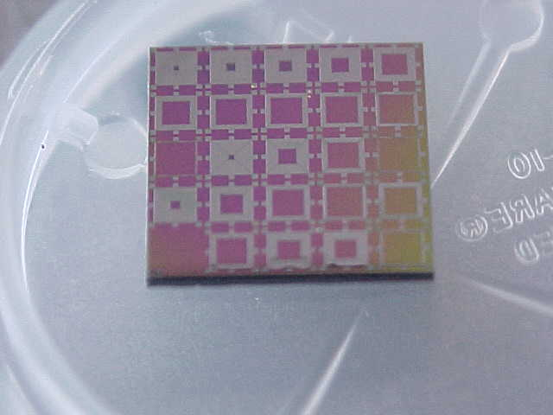


test taxel chip fabrication results
tactile stimulator test chip
with 11 different inner
radii
openings between inner
and outer chamber volume
50 μm
bottom electrode of
actuator (polysilicon)
Kapton common
membrane (post-fab)
1.54 mm
L_{inner}
L_{outer}
upper electrode of
actuator (polysilicon)

Slide 108



long term goal: build on flexible silicon membranes

